Slide 1
Scientific Notation

Slide 2
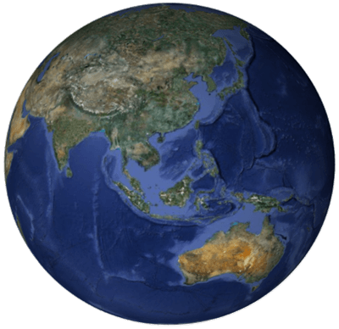
There are lots of numbers in the world that are very large or very small. These numbers are so large or small that it is troublesome to write them out in full.
The mass of the Earth, for example, is about 6,000,000,000,000,000,000,000,000 kg. That’s a lot of zeros! Instead of counting how many zeros we’ve written, we can use powers of tens with positive or negative indices to efficiently write these numbers.
This form of expression is called scientific notation or standard form.
First, let's review multiplying and dividing by powers of ten.

Slide 3
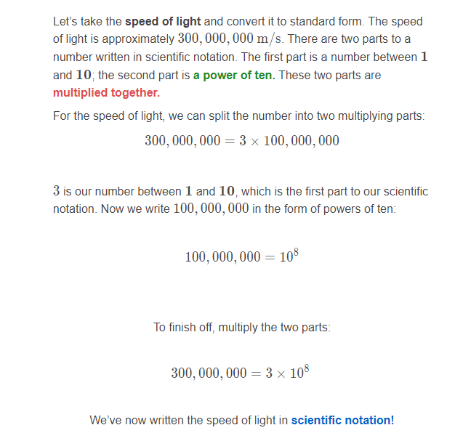
Let’s look at how we write in scientific notation.

Slide 4
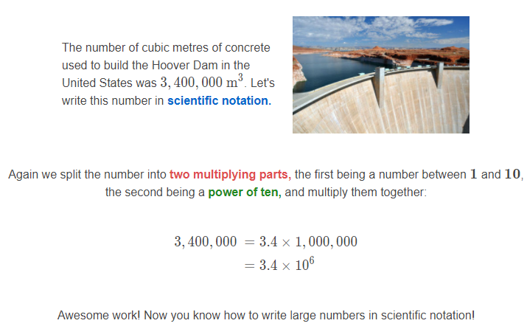
Let’s take a look at another example.

Slide 5
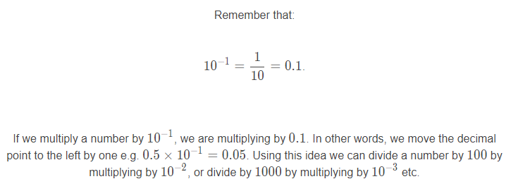
Aside from large numbers we also encounter very small numbers. For small numbers we use negative powers of ten.

Slide 6
Let’s use our understanding of indices to write 0.000894 in scientific notation.
To write a decimal number in scientific notation, we place the decimal point to the right of the first non zero digit. The first non zero digit of 0.000894 is 8, so we place the decimal point after 8 which gives 8.94. This is the first part of our scientific notation. Now we have to find the power of ten.
That is, we need to find which number goes in place of the question mark in this equation:
8.94×?=0.000894

Slide 7
